Slide 1
Masaaki Imai: The Father of Kaizen
Presented By:
Zahra Eman
Saiqa Manzoor
Mehwish Aslam

Slide 2
Objective:
This presentation explores the life and work of Masaaki Imai, the influential pioneer of Kaizen, a philosophy for continuous improvement. We'll delve into the origins, principles, and applications of this powerful concept.

Slide 3
Who is Masaaki Imai?
Visionary Leader:
Masaaki Imai is a famous management expert and writer who introduced the concept of "Kaizen" (continuous improvement) to the Western world.
Kaizen Institute Founder:
He established the Kaizen Institute in 1985 to promote Kaizen principles and implement them in organizations worldwide.

Slide 4

The Origins of Kaizen:
Japanese Roots:
Kaizen, meaning "continuous improvement," began in Japan after World War II as a method to rebuild the economy and improve manufacturing.
Toyota's Influence:
Toyota Motor Corporation led the way in using Kaizen, emphasizing waste reduction and improving efficiency.

Slide 5

The Principles of Kaizen:
Respect for People
Continuous Improvement
Focus on Process
Eliminate Waste

Slide 6

The Kaizen Mindset:
Open to Ideas:
Encouraging a culture of openness to new ideas, suggestions, and feedback from all levels of the organization.
Continuous Learning:
A commitment to ongoing learning and development, embracing new knowledge and skills to enhance performance.
Collaboration:
Fostering a collaborative environment where team members work together to identify problems and solutions.

Slide 7
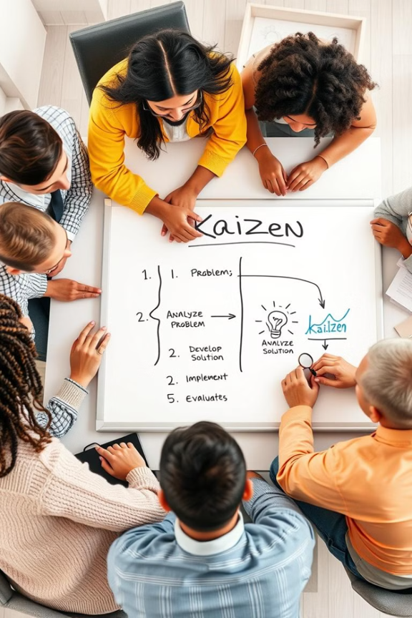
The Kaizen Event:
A structured, focused effort to improve a specific process, product, or service within a short period of time.
1
2
Involves a team of employees from different departments working together to identify problems, brainstorm solutions, and implement changes.
3
A key element of Kaizen, providing a hands-on opportunity to apply Kaizen principles and achieve tangible results.

Slide 8
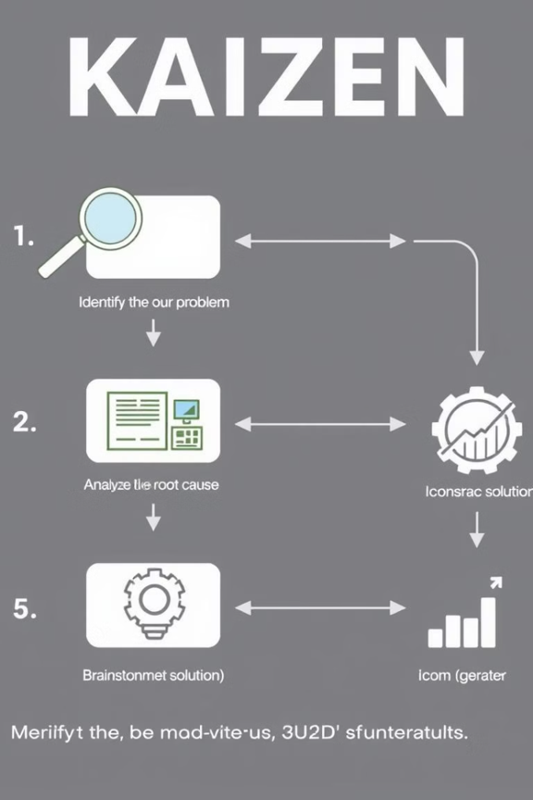
The Kaizen Event: Step-by-Step
Problem Identification:
The team identifies a specific problem or area for improvement within the organization.
Cause Analysis:
They analyze the root causes of the problem through data collection and brainstorming.
Solution Development:
The team develops and proposes potential solutions based on their analysis.
Implementation and Evaluation:
The proposed solutions are implemented and their effectiveness is evaluated.

Slide 9
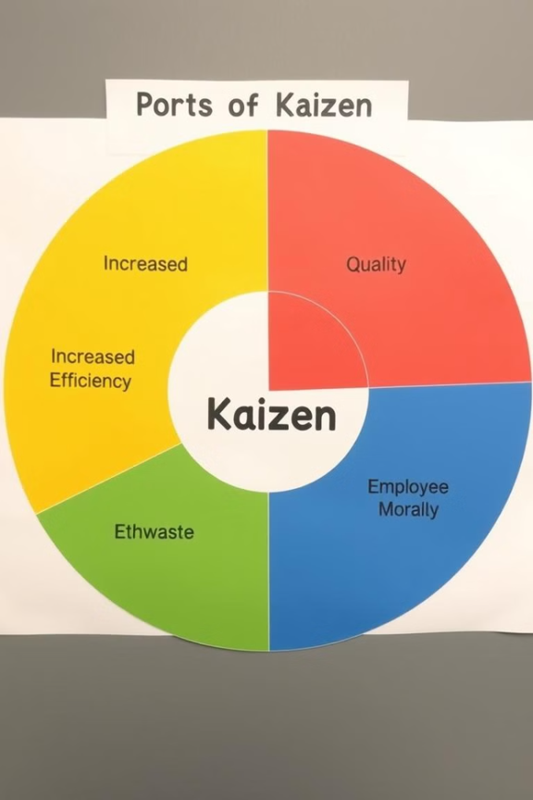
The Benefits of Kaizen:
15%
Cost Reduction
Kaizen can significantly reduce costs by eliminating waste and improving efficiency.
10%
Increased Productivity
Streamlined processes and improved teamwork result in higher output.
20%
Quality Improvement
Kaizen leads to higher product and service quality, enhancing customer satisfaction.
5%
Employee Empowerment
Kaizen empowers employees to take ownership and contribute to improvement

Slide 10
Implementing Kaizen in your Organization:
1
Leadership Support
2
Training and Education
3
Implementation and Evaluation
5
4
Team Formation
Problem Identification and Solution Development

Slide 11

Kaizen: The Path To Continuous Improvements:
By embracing Kaizen principles, organizations can foster a culture of continuous improvement, leading to increased efficiency, enhanced quality, and greater employee engagement. It's a journey of ongoing growth and development, driven by a commitment to excellence.

Slide 12
ANY QUESTION ?

Slide 13
THANK YOU

